Slide 1
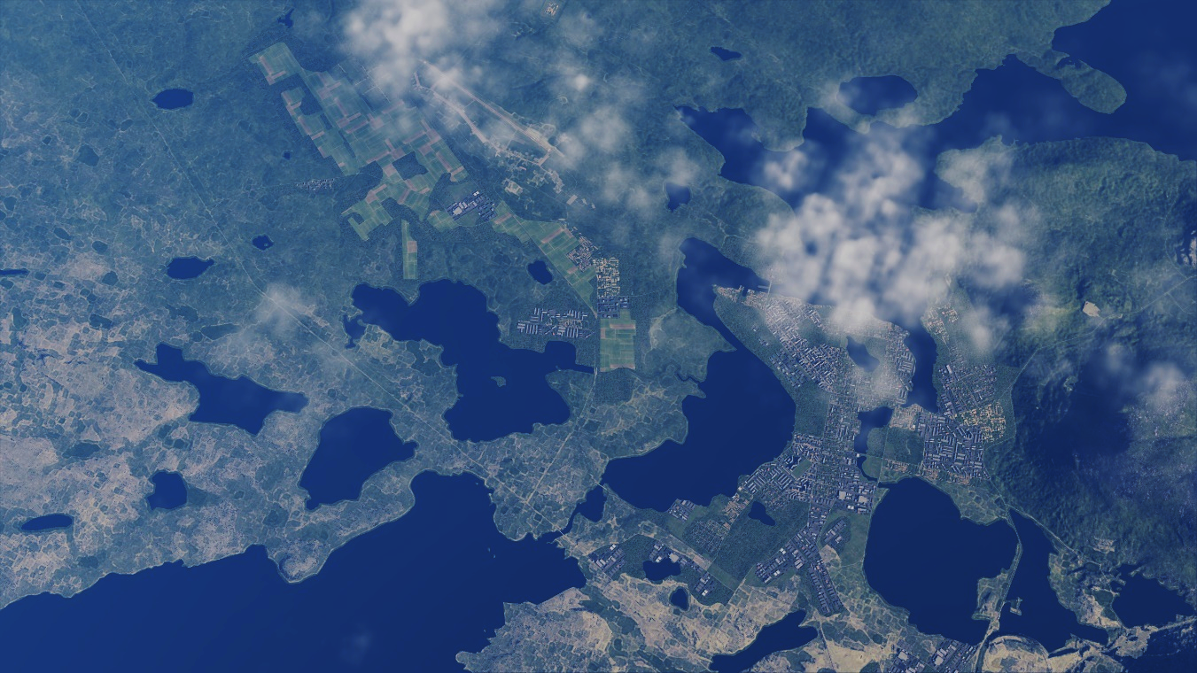
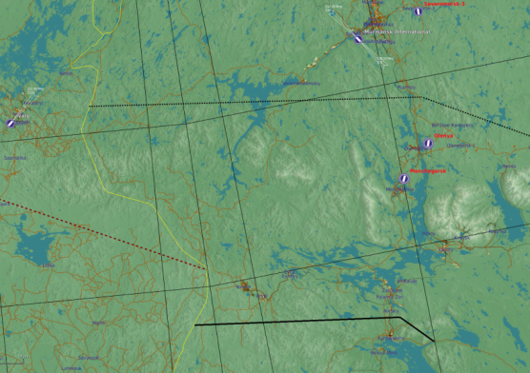


SRNTGT092 Monchegorsk Rocket Factory
Monchegorsk Airbase
N 67 57.677 E 032 52.026 – 480 ft
Monchegorsk Rocket Factory
N
Monchegorsk City
SRNTGT092
Monchegorsk rocket factory produces the majority of rockets needed by the rocket artillery forces. The factory produces 75% of the needed rockets for Notian armed forces. Destruction of this facility will greatly reduce the offensive firepower by Notian rocket artillery.

Slide 2
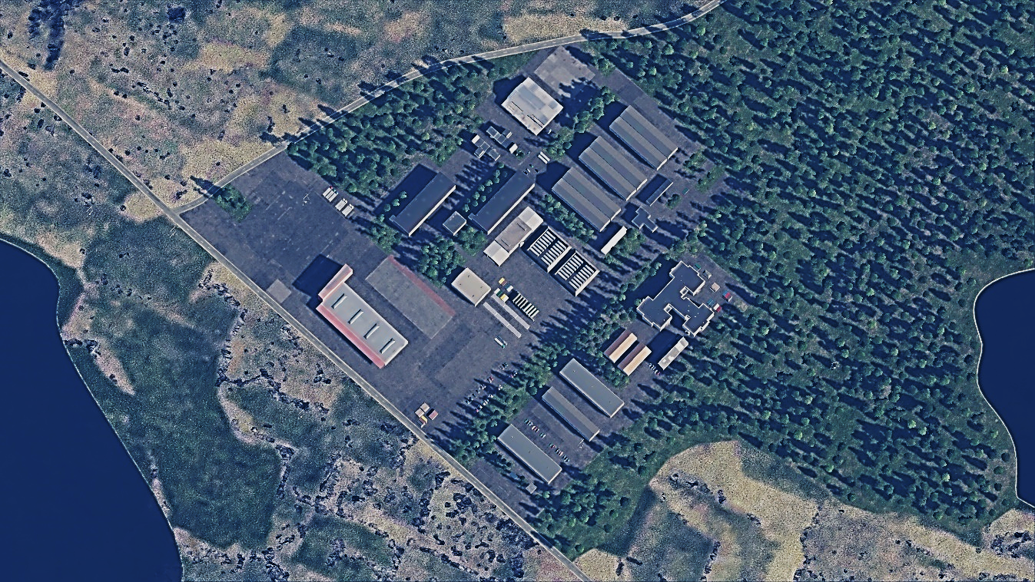
SRNTGT092 Monchegorsk Rocket Factory
SRNTGT092 -A: Rocket production facility 1
Large concrete building with 3 levels, 4 different impact points is required for desired effect, DPI A1 through A4
SRNTGT092 -B: Rocket production facility 2
Final assembly line, large one story building
SRNTGT092 -C: Power to production facilities
SRNTGT092 -D: Chemicals to production facility
SRNTGT092 -E: Chemicals to production facility
SRNTGT092A 1-4
N
SRNTGT092D
SRNTGT092C
SRNTGT092E
SRNTGT092B
DESCRIPTION OF THE DESIRED POINTS OF IMPACT WITH WPN TYPE
SRNTGT092 -A: Rocket production facility 1
A1 N 67 57.679 E 032 51.999 – 480 ft – 1X 500 lbs
A2 N 67 57.676 E 032 51.992 – 480 ft – 1X 500 lbs
A3 N 67 57.671 E 032 52.034 – 480 ft – 1X 500 lbs
A4 N 67 57.667 E 032 52.029 – 480 ft – 1X 500 lbs
SRNTGT092 -B: N 67 57.689 E 032 51.934, – 480 ft - 1x2,000 lbs required
SRNTGT092 -C: N 67 57.703 E 032 52.018, – 480 ft - 1x2,000 lbs required
SRNTGT092 -D: N 67 57.656 E 032 52.006, – 480 ft - 1x1,000 or 1x2,000 lbs required
SRNTGT092 -E: N 67 57.639 E 032 51.980, – 480 ft - 1x1,000 or 1x2,000 lbs required

